Slide 1
Living liquidz data analysis
Sarthak Shadangi

Slide 2
AGENDA
Introduction
Objective​
Approach
Insights
Dashboard
​Challenges faced
Conclusion

Slide 3
Introduction
Founded in the year 1970 Living Liquidz has thousands of brands of alcohol from across the globe with their unique experience and flavors.

Slide 4
objective
To scrape data from livingliquidz.com, analyze the data and create a dashboard showing key insights.

Slide 5
approach
Web scraping
Data cleaning
dashboard
presentation
Web scraping using BeautifulSoup library of Python
Data cleaning, null handling, outlier removal using power query
Insights & dashboard using Power BI
Created presentation to show the flow of the project

Slide 6
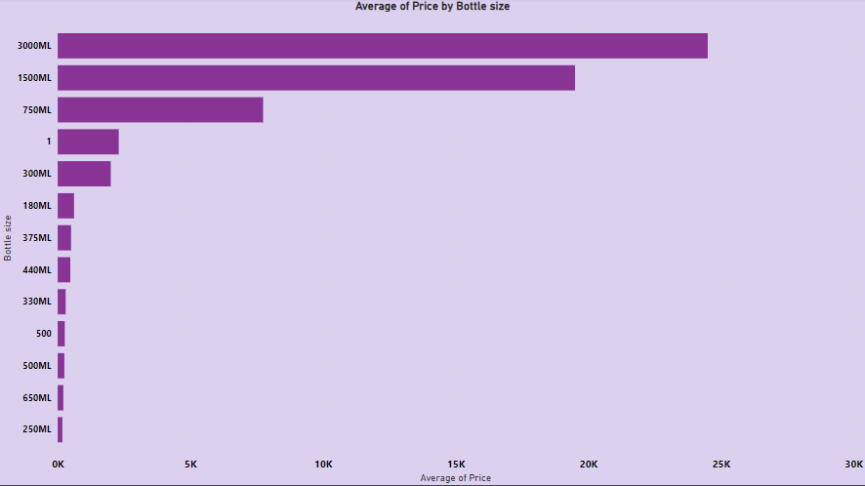
Avg price w.r.t. bottle size

Slide 7
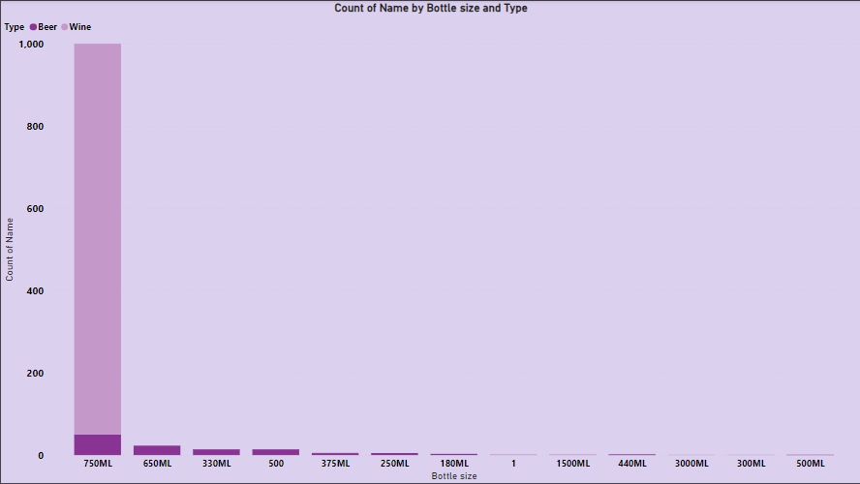
Count of liquor by bottle size & type

Slide 8
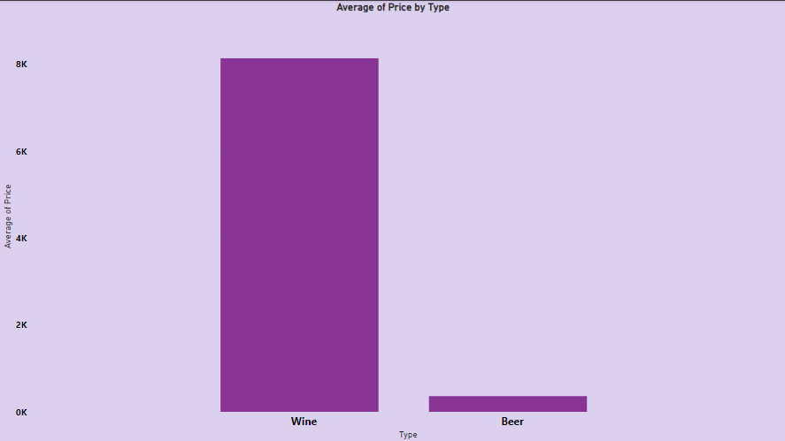
Avg price by type

Slide 9
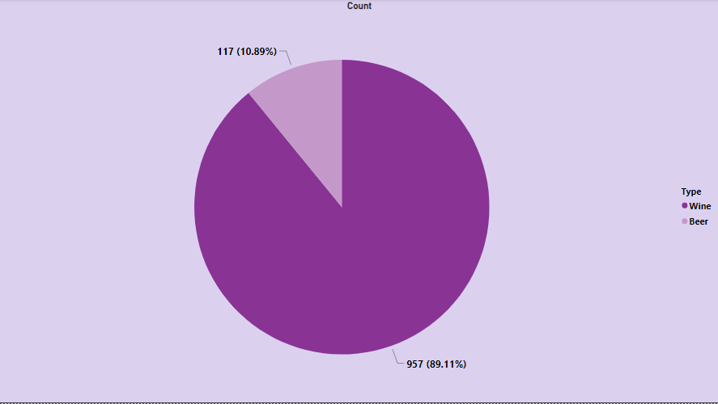
proportion of type

Slide 10
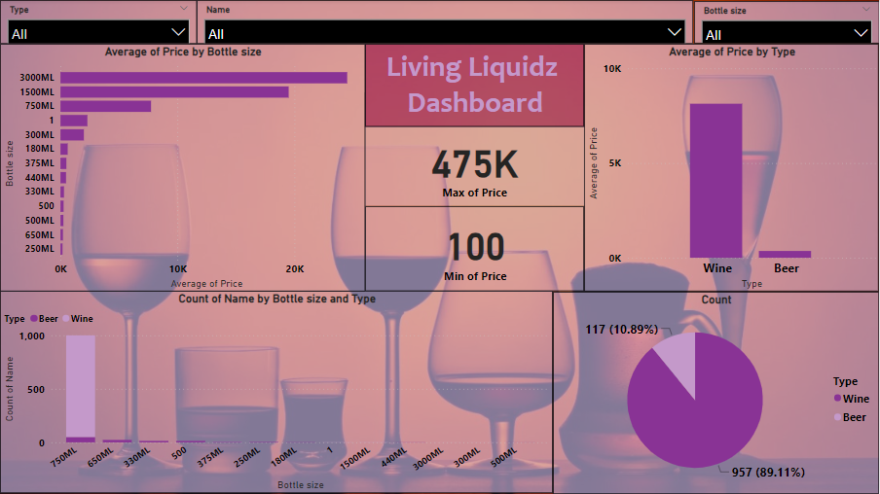
dashboard

Slide 11
Challenges faced
Web scraping of the site.
Data cleaning of the raw data in csv.
Combining dataframe as one dataframe.

Slide 12
conclusion
Total Wines- 1019
Domestic- 162
Imported- 857
Total Beers- 117
Domestic- 102
Imported- 15
Max price of wine- 475000
Min price of wine- 750
Max price of beer- 695
Min price of beer- 100

Slide 13
THANK YOU
Sarthak Shadangi
Linkedin
Github

